Slide 1
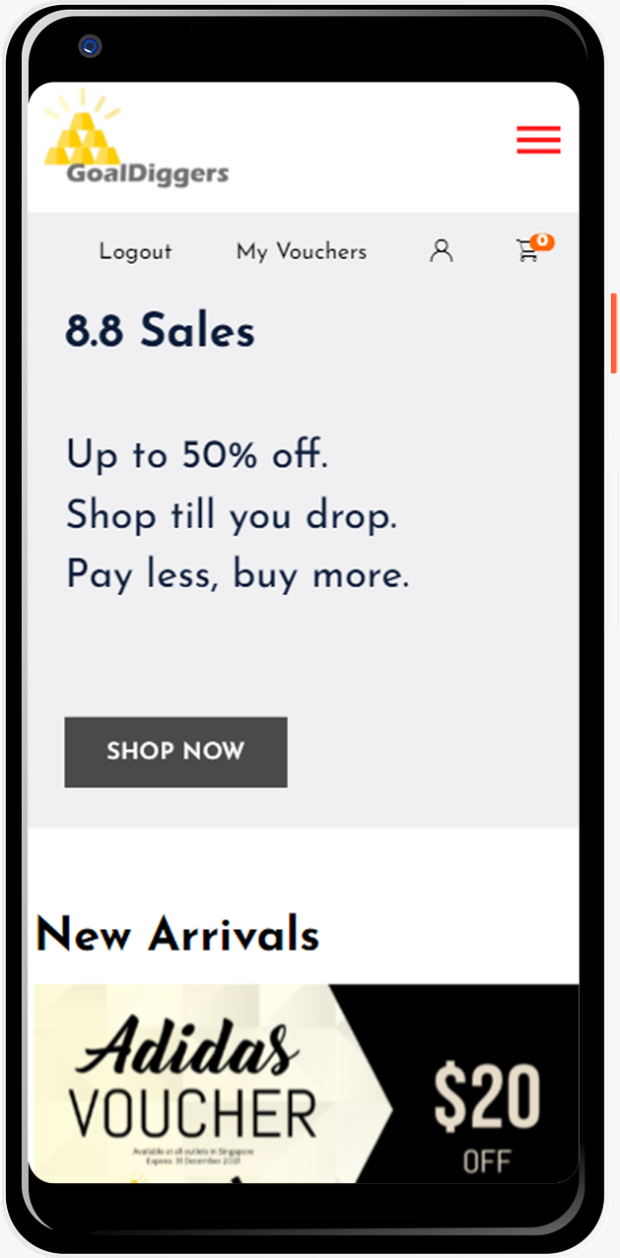
GoalDiggers
CitiHackOverflow
Team 1
Brendon Lim
Earnest Ng
Neo Jia Ying
Wong Kin Hou
Wong Wei Ling

Slide 2
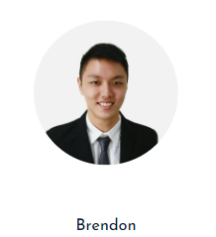
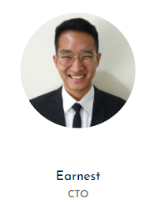


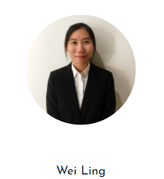
The Team
Backend
Frontend
Notes:
Contents:
1. Background and Problem Statement
2. Solution and User Interface
3. Features of the applications - benefits and how it addresses problems
4. Workflow design/architecture/technology stack of the applications (include diagrams if possible)
5. Project Timeline, Key Metrics and Testing

Slide 3
Problem Statement
1

Slide 4


Empathize
Research on gap between click and mortar shopping experiences:
Brick and mortar retail has declined recently but is bouncing back. (Schnure, 2021)
The convenience of e-commerce is unmatched by physical retailers.
Physical retailers lack the personalization their virtual counterparts provide to consumers.
Notes:
Schnure, C. (2021). Brick-And-Mortar Retail Is Bouncing Back. Retrieved from https://www.forbes.com/sites/calvinschnure/2021/03/18/brick-and-mortar-retail-is-bouncing-back/?sh=441322b8d0f4

Slide 5

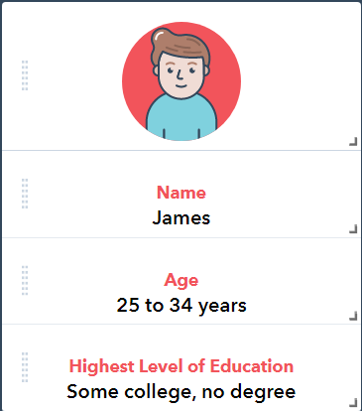
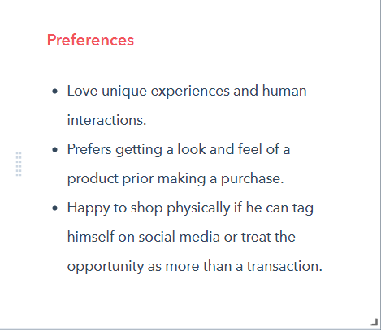

Define
Identify challenges and pain points shoppers and physical retailers face:
Physical retailers lack avenues to collect data and derive insights.
Interactions with brick and mortar stores end the moment a consumer leaves the store.
Notes:
Schnure, C. (2021). Brick-And-Mortar Retail Is Bouncing Back. Retrieved from https://www.forbes.com/sites/calvinschnure/2021/03/18/brick-and-mortar-retail-is-bouncing-back/?sh=441322b8d0f4

Slide 6
Problem Statement
The fear of prolonged physical exposure along with extensive physical contact deters consumers from brick and mortar stores.

Slide 7
Solution &
User Experience
3

Slide 8
Solution
To strive and capitalize on opportunities beyond the pandemic, by focusing on experiences that entice customers to keep coming back.

Slide 9


Ideate
Brainstorm for innovative ideas
Members add on to each other’s ideas with the aim of coming up with as many potential ideas as possible.
Ideas are then narrowed to the most suitable solutions according to problem statement

Slide 10
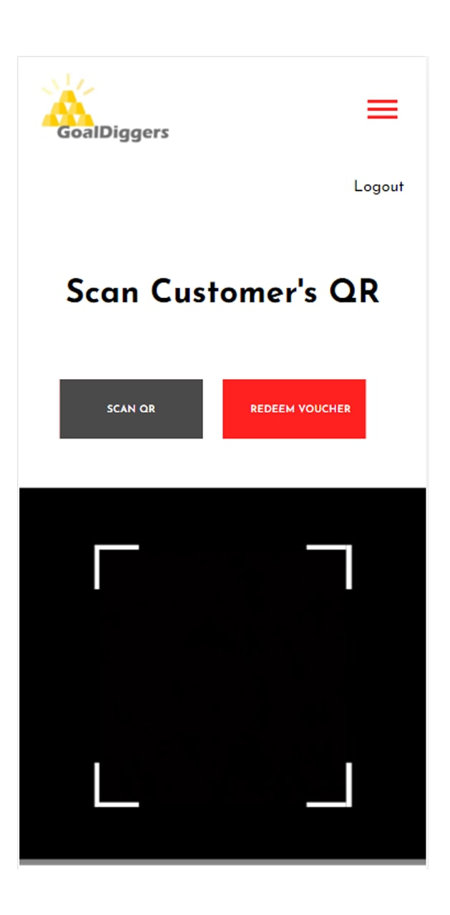
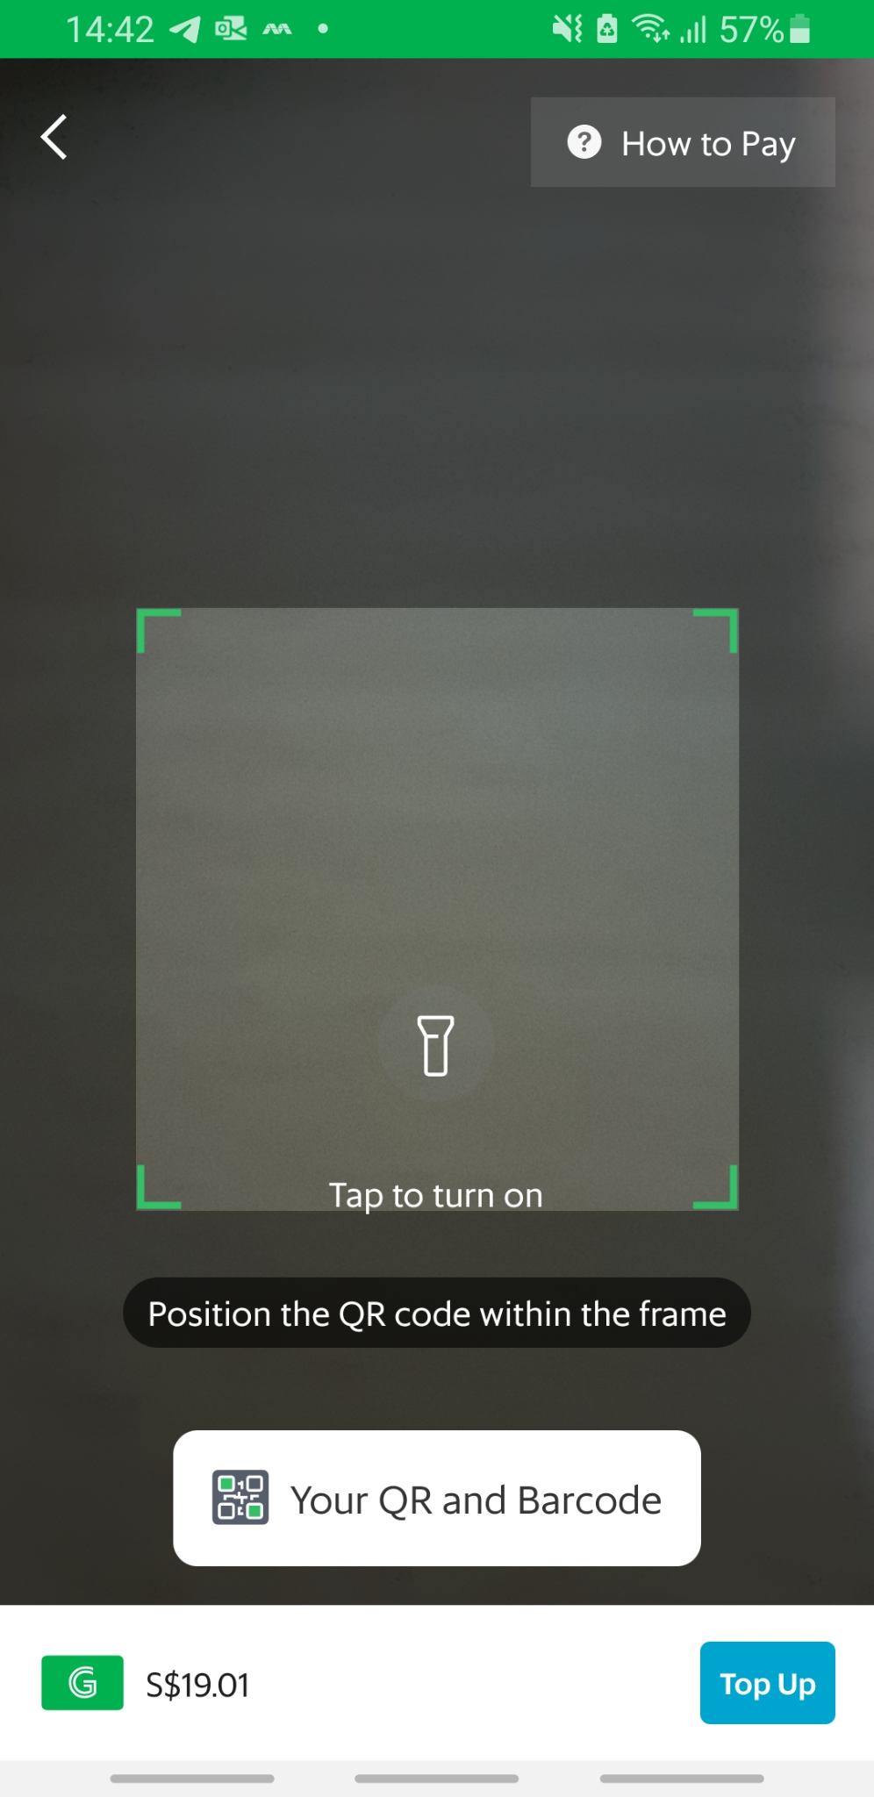
Prototype Inspirations
Research on other reputable e-commerce sites for best practices.
Our Solution
Grab

Slide 11

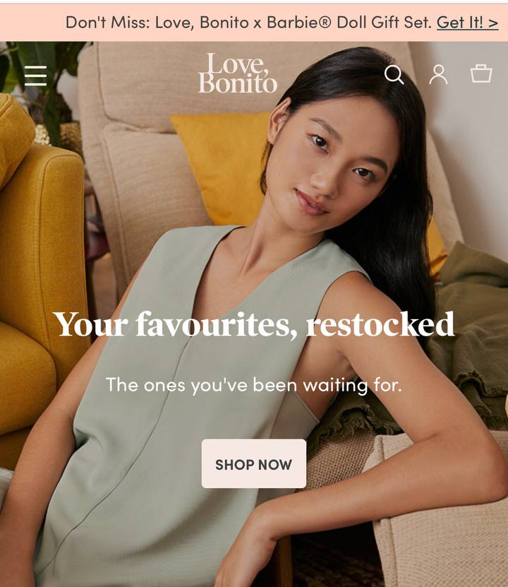
Prototype Inspirations
Research on other reputable e-commerce sites for best practices.
Our Solution
Love Bonito

Slide 12

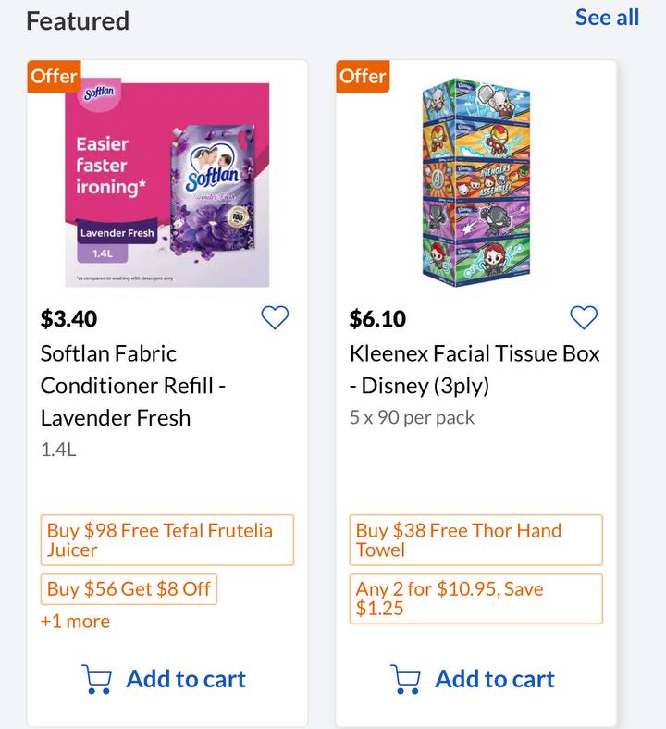
Prototype Inspirations
Research on other reputable e-commerce sites for best practices.
Our Solution
Fairprice

Slide 13
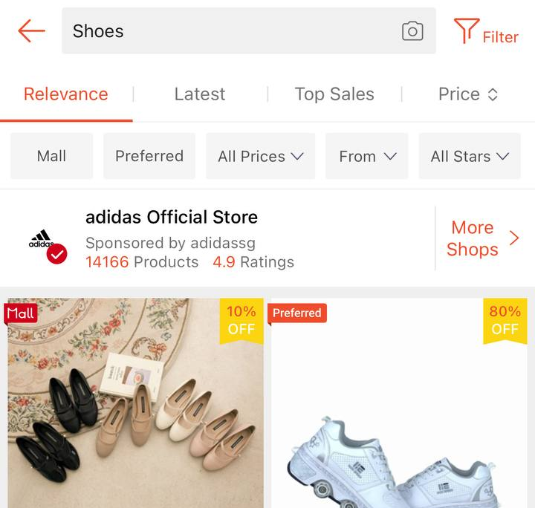
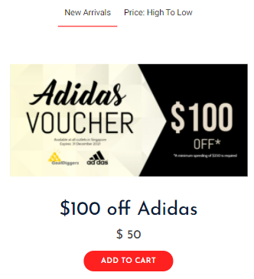
Prototype Inspirations
Research on other reputable e-commerce sites for best practices.
Our Solution
Shopee

Slide 14
GoalDigger
4

Slide 15







Tools
Frontend
Backend
Database
15

Slide 16
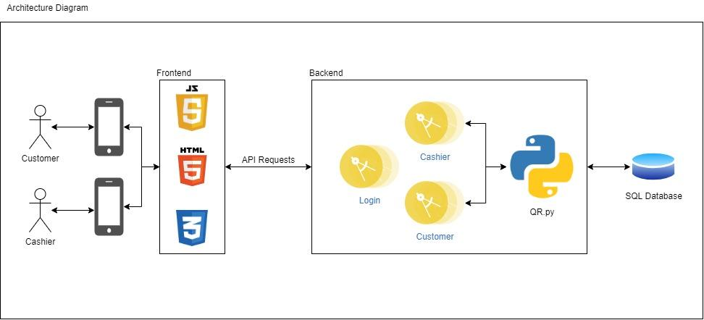
Architecture
16

Slide 17
Key Features - Customer
View Loyalty Points Earned
Purchase Vouchers
Redeem Vouchers
Vouchers Status
Purchase merchants’ voucher.
Redeem vouchers offline using QR code.
Once redeemed, refund and/or reuse is not allowed.
Categorized vouchers as Usable/Redeemed/Expired for ease of use
Loyalty points earned from online shopping.

Slide 18
Key Features - Cashier
Scan QR
Redeem Vouchers
Update customers’ account with loyalty points
Scan customers’ QR code
Vouchers will be redeemed once QR code is scanned
Once transaction is completed, customers’ loyalty points will be updated

Slide 19
Flow
5

Slide 20
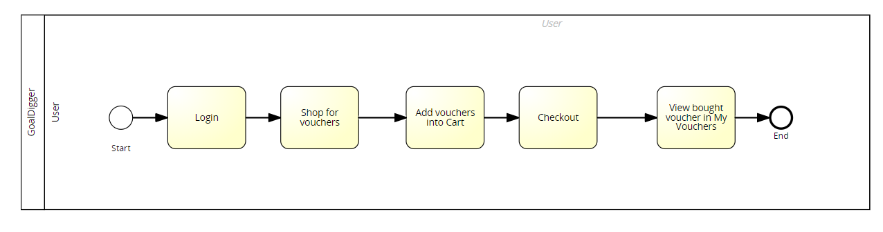
User Flow
User - Shop for Vouchers and Checkout & View my Vouchers

Slide 21
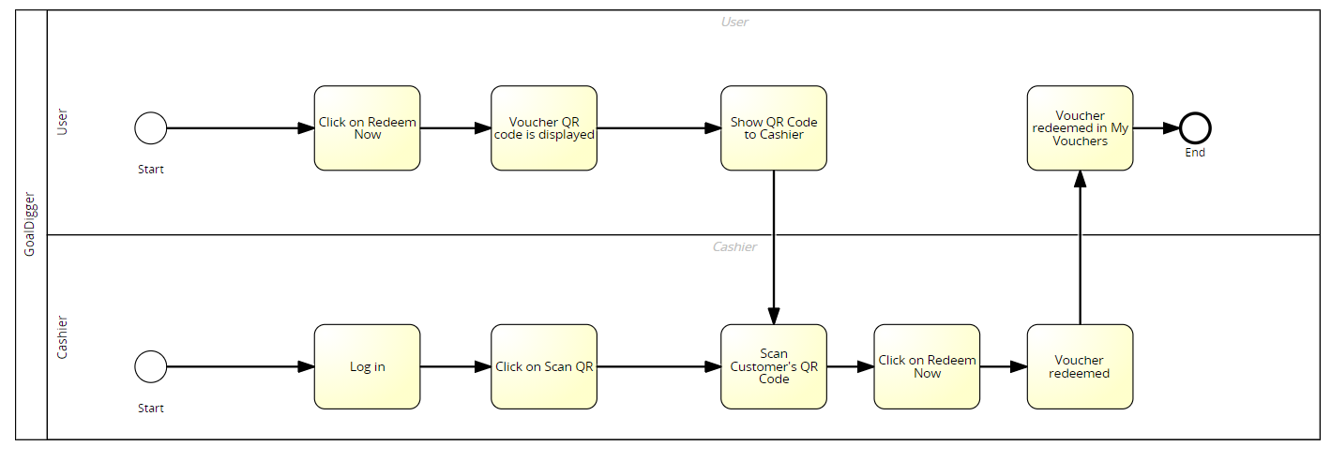
User/Cashier Flow (Redeem Voucher)
User/Cashier - Redeem Voucher

Slide 22
Live Demo
5

Slide 23
Project Management
6

Slide 24
Project Timeline
 | Week 1
 | 1 | 2 | 3 | 4 | 5 | 6 | 7
Empathize with audience & Define problem statement
Ideate - brainstorm ways to identify unmet needs |  |  |  |  |  | ◆
Prototype - static frontend design
Prototype - QR code & 3 microservices (backend)
Prototype - integration of frontend with backend
Prototype - edits for responsive website
Test
Preparation of Slides

Slide 25
Key Metrics
7

Slide 26
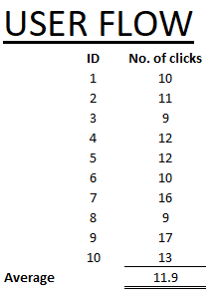
User Flow
User - Shop for Vouchers, Checkout & View my Vouchers
Intended # of clicks: 9
Average # of clicks: 11.9

Slide 27
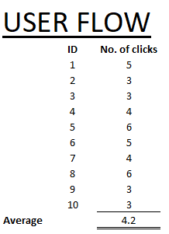
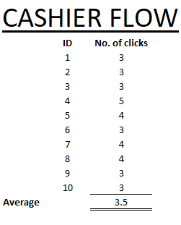
User/Cashier Flow
User/Cashier - Redeem Voucher
Intended # of clicks for User: 3
Average #clicks for User: 4.2
Intended # of clicks for Cashier: 3
Average # of clicks for Cashier: 3.5

Slide 28
Final
Testing
8

Slide 29
Testcases - Customer
# | Description | Steps Taken | Expected Result | Actual Result | Pass/Fail
1 | Create Account | Go to Login/Register page and create an account | Triggers Account created successfully message Account added to database | Triggers Account created successfully message Account added to database | Pass
2 | Login | Go to Login/Register page and login with created account | Able to log in | Able to log in | Pass
3 | Logout | Click on Logout on navbar | Logged out | Logged out | Pass

Slide 30
Testcases - Customer
# | Description | Steps Taken | Expected Result | Actual Result | Pass/Fail
4 | Navbar | Login and Logout | Navbar elements should change accordingly to whether user is logged in or logged out | Navbar for login - Logout, My Vouchers, Profile, Cart Navbar for logout - Login/Register | Pass
5 | Add to Cart | Add a voucher to the cart | Cart number increases by 1 Voucher is added to cart at cart page | Cart number increases by 1 Voucher is added to cart at cart page | Pass
6 | Clear Cart | Click on clear cart button in cart page | Carts get cleared | Cart is cleared | Pass

Slide 31
Testcases - Customer
# | Description | Steps Taken | Expected Result | Actual Result | Pass/Fail
7 | Checkout | Click on checkout button on cart page | Check out successfully Voucher bought is added to My Vouchers - Unused | Checked out successfully Voucher bought is added to My Vouchers - Unused | Pass
8 | Redeem voucher | Click on redeem now on My Vouchers page | QR Code generated | QR Code generated | Pass
9 | Redeemed Voucher | After cashier redeems voucher, refresh My Vouchers Page | Redeem Now button for redeemed voucher should be greyed out | Redeem Now button for redeemed voucher is greyed out | Pass

Slide 32
Testcases - Customer
# | Description | Steps Taken | Expected Result | Actual Result | Pass/Fail
10 | Expired Vouchers | Check expiration date of vouchers in database. Click on Expired tab under My Vouchers page | Redeem now button is greyed out for vouchers that have expired. | Redeem now button is greyed out for vouchers that have expired. | Pass

Slide 33
Testcases - Cashier
# | Description | Steps Taken | Expected Result | Actual Result | Pass/Fail
1 | Login | Go to Login/Register page and login as Cashier | Logged in as Cashier Landing page of Cashier is displayed | Logged in as Cashier Landing page of Cashier is displayed | Pass
2 | Logout | Click on Logout button | Logged out as cashier | Logged out as cashier | Pass
3 | Scan QR | Login as Cashier Click on Scan QR button | Camera shows up for cashier to scan customer’s QR | Camera showed up for cashier to scan customer’s QR | Pass

Slide 34
Testcases - Cashier
# | Description | Steps Taken | Expected Result | Actual Result | Pass/Fail
4 | Scan QR | Place customer QR infront of camera | Voucher details and status should appear | Voucher details and status appeared | Pass
5 | Redeem QR - Status - Redeemable | Click on redeem QR | Status of voucher should change to redeemed on webpage Database status of voucher changes to Redeemed | Status of voucher should changed to Redeemed Database status of voucher updated | Pass

Slide 35
Testcases - Cashier
# | Description | Steps Taken | Expected Result | Actual Result | Pass/Fail
6 | Redeem QR - Status - Redeemed | Scan a redeemed voucher QR code | Status of voucher should already be in redeemed Status of voucher changes to Voucher redeemed Database status of voucher remains the same | Status of voucher should already be in redeemed Status of voucher changes to Voucher redeemed Database status of voucher remains the same | Pass

Slide 36
Future Work
8

Slide 37
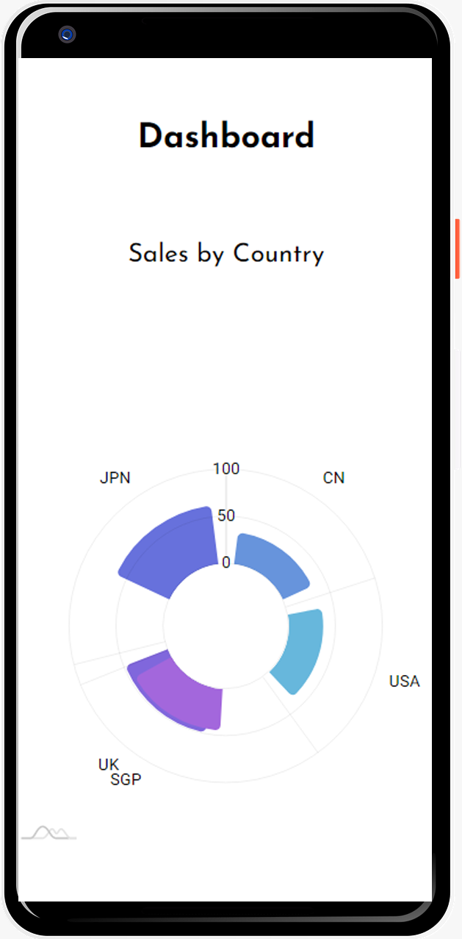
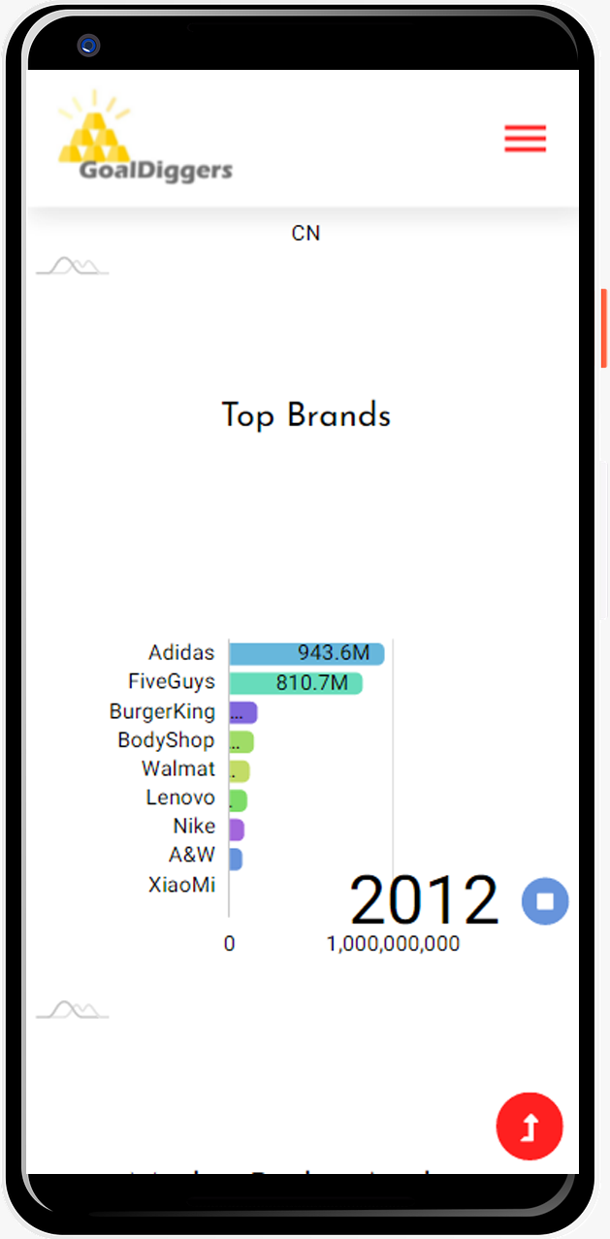
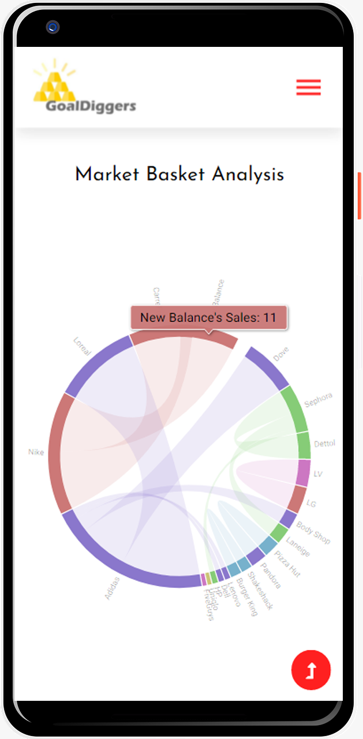

Features - Cashier
Stripe API
Dashboards
Integrate Stripe API for payments
Generate insights
Ease of visualisations

Slide 38
Thank You

